Slide 1
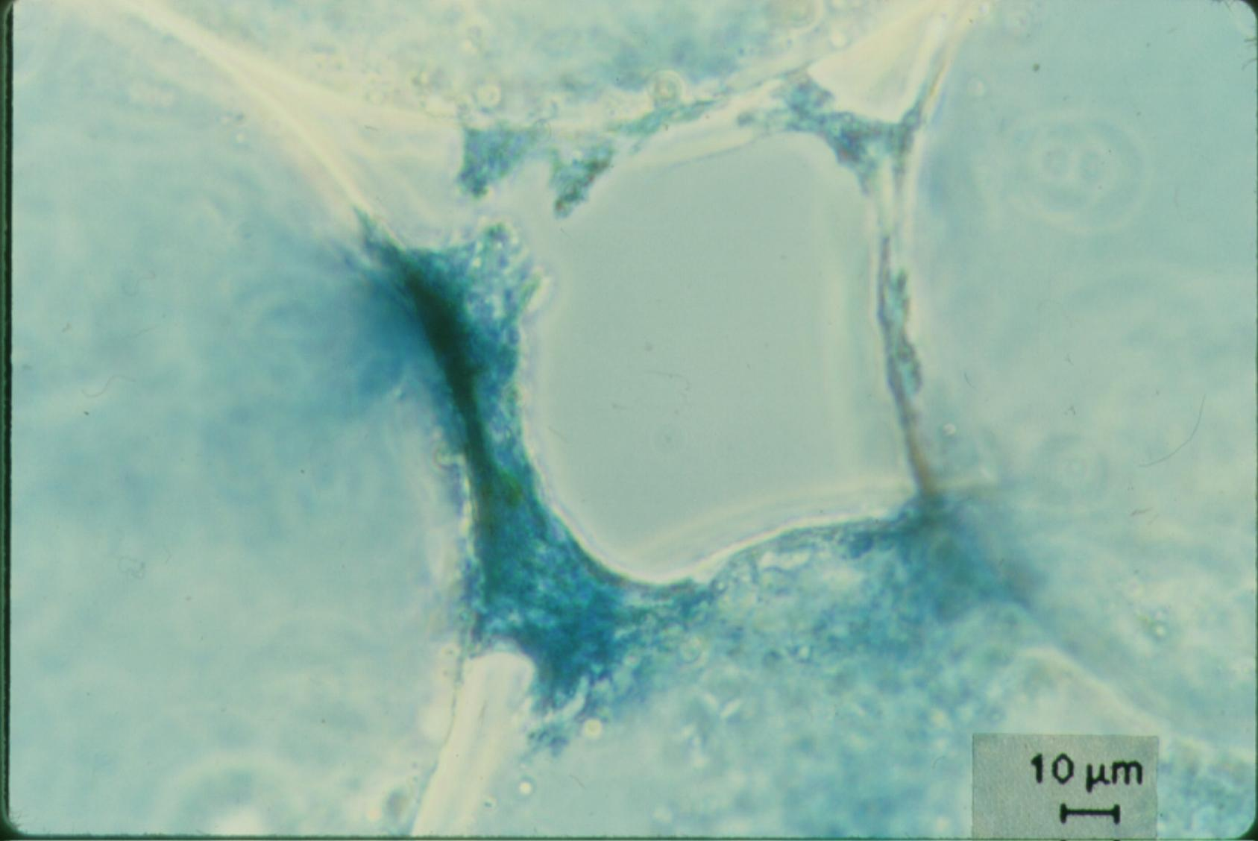
Filtration Theory
On removing little particles with big particles

Slide 2
Filtration Outline
Sand Filters
Slow sand (SSF)
Rough Gravel (RGF)
Dynamic Gravel (DGF)
Rapid (RSF)
Stacked Rapid (StaRS)
Range of applicability
Net Velocity
Hydraulics
Particle Capture theory
Transport
Dimensional Analysis
Model predictions
Methods to improve performance

Slide 3
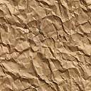
Particle Removal Mechanisms in Filters
Transport to a surface
collector
Molecular diffusion
Inertia
Gravity
Interception
Attachment
Straining
Coagulant nanoparticles
Gravity

Slide 4
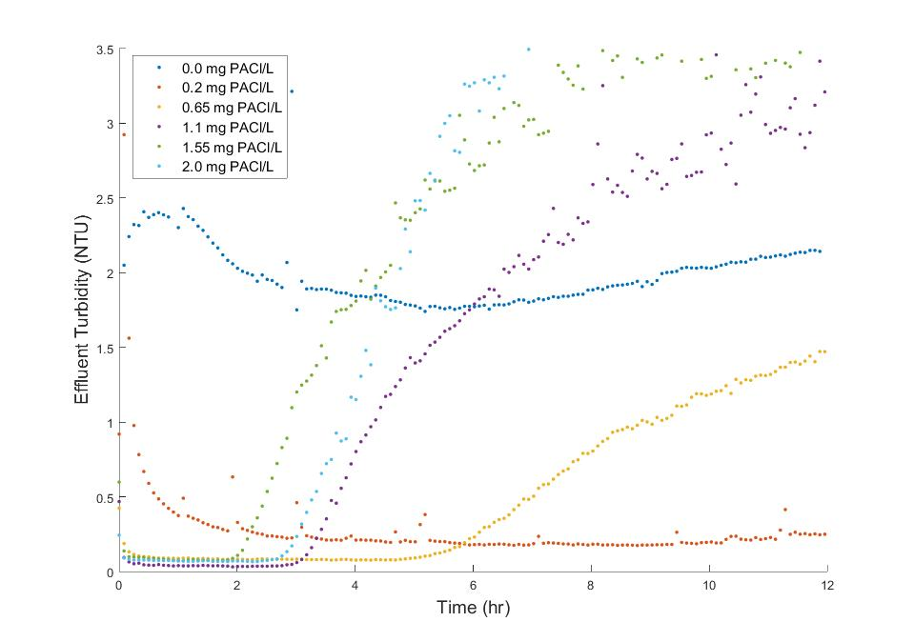
Very steep failure
1.55 mg/L
0.65 mg/L
Lucinda Li, Theresa Chu, Jonathan Harris, Mythri Krishnamoorthysujatha, Rose Linehan, William H. Pennock
Notes:
Lucinda Li, Theresa Chu, Jonathan Harris, Mythri Krishnamoorthysujatha, Rose Linehan, William H. Pennock

Slide 5
Active filtration zone slowly moves down through the filter
Effluent Turbidity
NTU
Time

Slide 6
Active Filtration zone
Backwash debris
Active zone breakthrough
(large flocs likely get to the bottom of the filter first)
Loaded zone
Filtration improves while loaded zone expands and clean zone shrinks
Therefore particle removal is better in loaded zone than in clean zone!
Active Filtration zone
NTU
Clean zone
Time

Slide 7
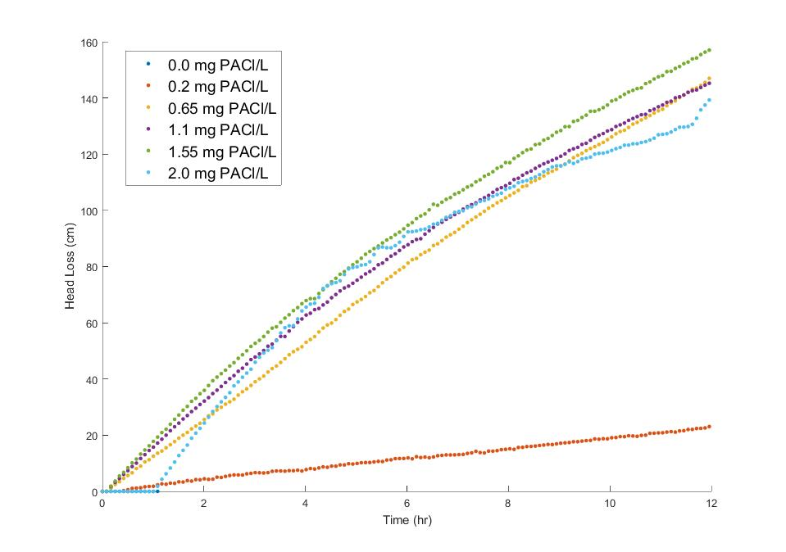
Head loss in Filters is close to linear before breakthrough
0.65 mg/L
1.55 mg/L
Breakthrough
Notes:
With bigger flocs there is less head loss at breakthrough!
With bigger flocs there is more head loss per mass of particles removed

Slide 8
Head loss and filter fraction loaded increase linearly together
Head loss continues to increase after the active zone reaches the filter effluent
Head loss increases MORE SLOWLY after the active zone reaches the filter effluent

Slide 9
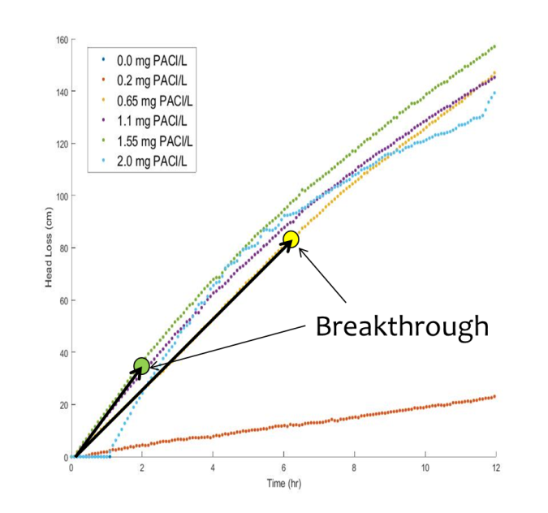
Head loss in filters is close to linear before breakthrough
Why does increased coagulant dose result in earlier failure?
bigger flocs occupy more volume AND they aren’t able to attach to partially filled constrictions
Why is head loss accumulation faster with more coagulant?
bigger flocs must occupy more plan view area of a constriction
1.55 mg/L
0.65 mg/L
Notes:
Remember that these experiments were direct filtration (no sedimentation!)
Thus it is the big flocs that exit the filter first!!!!
Big flocs are likely harder for constrictions to capture because of the higher shear (same reason why big flocs are likely not captured as well in floc blankets)

Slide 10
Why is head loss at failure lower at higher coagulant dose?
If we assume that most of the filter pores had formed constrictions at breakthrough, then the pressure drop per constriction is lower at the higher coagulant dose
Inconsistent with the hypothesis that more coagulant leads to stronger bonds
Consistent with hypothesis that larger flocs can’t attach as easily because the drag force is higher
Bigger flocs aren’t able to attach to partially filled constrictions!

Slide 11
Influent floc size distribution might have a major influence on performance
Dominated by large flocs (high coagulant dose with no floc blanket or plate settlers)
rapid increase in head loss (large flocs are less dense)
less head loss per restriction at break through
Breakthrough caused by large flocs
Dominated by primary particles (after floc blanket and plate settlers)
slow increase in head loss per mass of primary particles removed
high head loss per restriction at break through
Breakthrough could be caused by a few large flocs if large flocs are present or it could be caused by primary particles if there aren’t any large flocs present

Slide 12
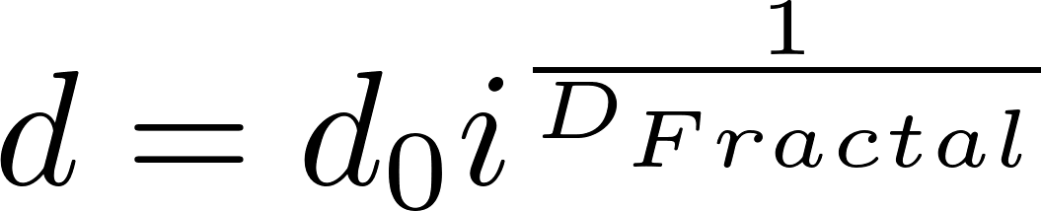
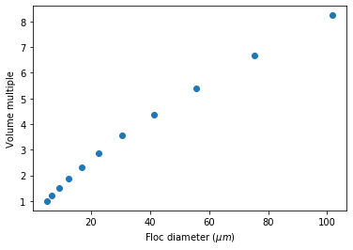
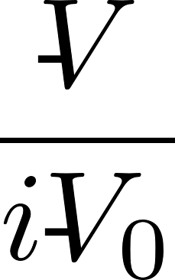
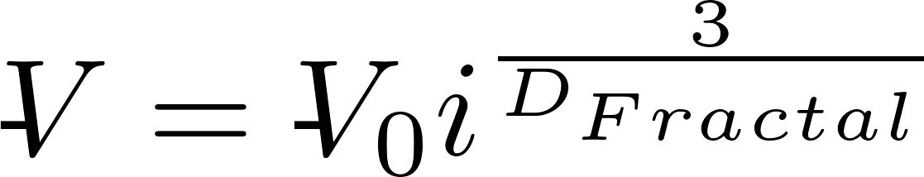
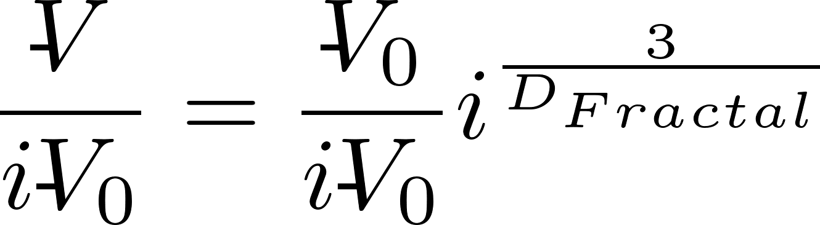
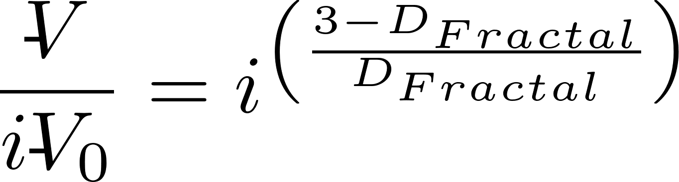
Volume occupied by flocs increases as flocs increase in size
Big flocs occupy more volume!
i is number of primary particles
Notes:
The volume occupied by the particles increases rapidly as the flocs increase in diameter.
The analysis below is for doubling collisions
max_collisions = 10
i_collisions = np.linspace(0,max_collisions,max_collisions+1)
i_particles = 2**i_collisions
d_clay = 5 * u.um
D_fractal = 2.3
d_floc = d_clay * i_particles**(1/D_fractal)
volume = i_particles**((3-D_fractal)/D_fractal)
plt.plot(d_floc,volume,'o')
plt.xlabel(r'Floc diameter ($\mu m$)')
plt.ylabel('Volume multiple')

Slide 13
Reducing the capture velocity on the plate settlers increases filter run times!
Big flocs fill a filter much quicker than the same mass of clay in smaller flocs
Reducing the capture velocity in the sed tank removes ever smaller flocs and it is the largest flocs that occupy the most volume per mass of clay
Sed tank capture velocities must have a significant impact on filter run times!

Slide 14
Why might larger media (anthracite on top of sand) help?
The active filtration zone moves progressively down through the filter bed
This suggests that the sand under anthracite in a dual media filter is completely inactive (research is required)!
Bigger pores must be able to hold more large flocs with less head loss (we need a model!)
The sand may be included due to a misapplication of the clean bed filtration models (see MWH)

Slide 15
What do we know?
Flocs occupy a few percent of the void volume in a loaded filter
Insufficient floc volume to uniformly decrease void volume and increase fluid velocity, shear, and major losses
Head loss is close to linear with time
Head loss from constrictions is due (at least in part) to expansions!

Slide 16
Interception occurs where streamlines converge
No removal by interception in straight tube
Particles are deposited at the constriction
The biggest part of the filter pore remains empty!
Big particles can’t attach to partially filled restrictions

Slide 17
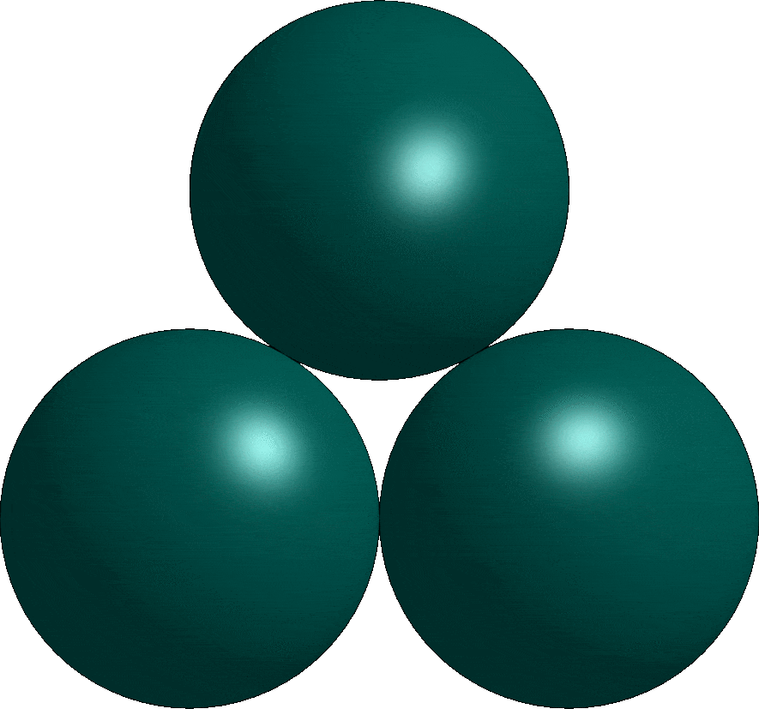

Evolving Constriction Geometry
Constriction height set by size of captured flocs

Slide 18
References
Tufenkji, N. and M. Elimelech (2004). "Correlation equation for predicting single-collector efficiency in physicochemical filtration in saturated porous media." Environmental-Science-and-Technology 38(2): 529-536.
Cushing, R. S. and D. F. Lawler (1998). "Depth Filtration: Fundamental Investigation through Three-Dimensional Trajectory Analysis." Environmental Science and Technology 32(23): 3793 -3801.
Tobiason, J. E. and C. R. O'Melia (1988). "Physicochemical Aspects of Particle Removal in Depth Filtration." Journal American Water Works Association 80(12): 54-64.
Yao, K.-M., M. T. Habibian, et al. (1971). "Water and Waste Water Filtration: Concepts and Applications." Environmental Science and Technology 5(11): 1105.
M.A. Elliott*, C.E. Stauber, F. Koksal, K.R. Liang, D.K. Huslage, F.A. DiGiano, M.D. Sobsey. (2006) The operation, flow conditions and microbial reductions of an intermittently operated, household-scale slow sand filter
Enhanced Filter Performance by Fluidized-Bed Pretreatment with Al(OH)3(am): Observations and Model Simulation Po-Hsun Lin, Leonard W. Lion, and Monroe L. Weber-Shirk. Journal of Environmental Engineering 1, 389 (2011).

Slide 19
Filtration Performance: Dimensional Analysis
Performance = f(forces, geometry)
What is the parameter we are interested in measuring? _________________
How could we make performance dimensionless? ____________
What are the important forces?
Effluent concentration
C/C₀ or pC*
transport
attachment
Inertia
Thermal
Sticky? (α – attachment efficiency)
Viscous
Gravitational
Need to create dimensionless force ratios!

Slide 20
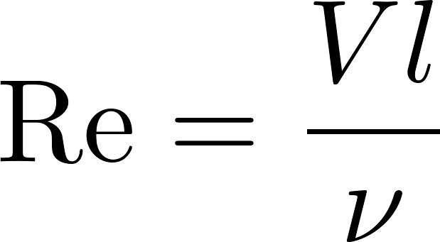
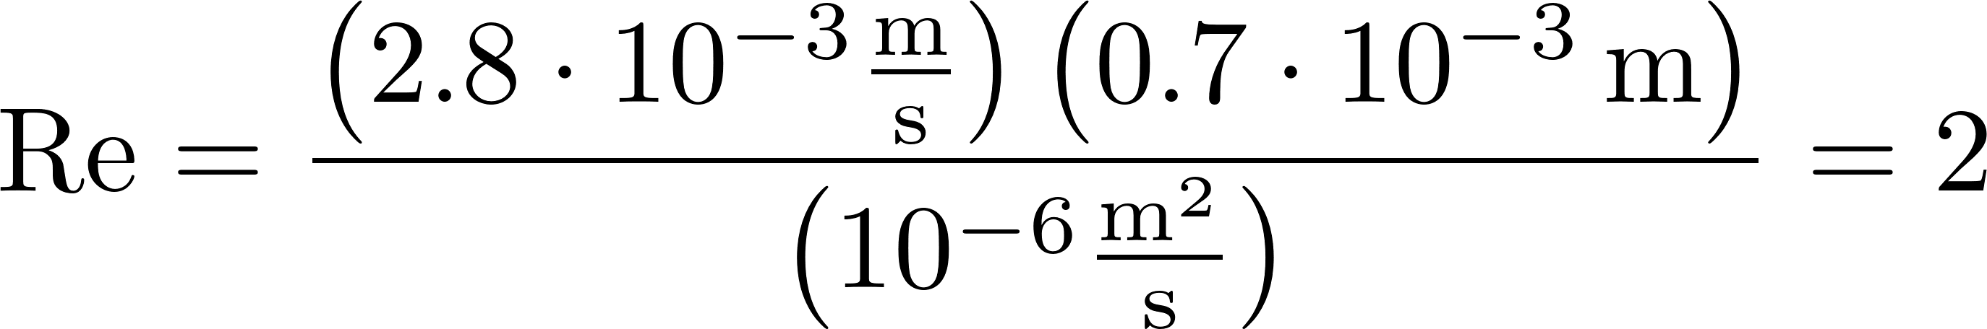
What is the Reynolds number for filtration flow?
What are the possible length scales?
Void size (collector size) 0.7 mm in RSF
Particle size
Velocities
V_{Fi} varies between 0.03 mm/s (SSF) and 2.8 mm/s (RSF)
Take the largest length scale and highest velocity to find max Re
Flow through SSF, RSF, and StaRS is laminar during filtration

Slide 21
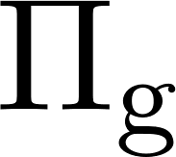
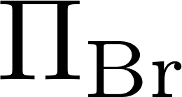
Choose viscosity!
In Fluid Mechanics inertia is a significant “force” for most problems
In porous media filtration viscosity is more important that inertia.
We will use viscosity as the repeating parameter and get a different set of dimensionless force ratios
Inertia
Gravitational
Thermal
Viscous
Viscous

Slide 22
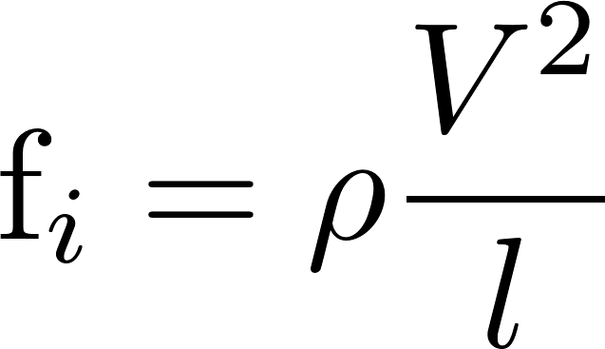
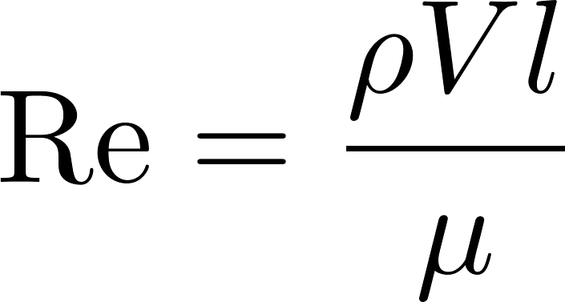
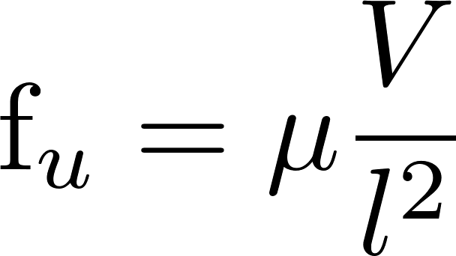
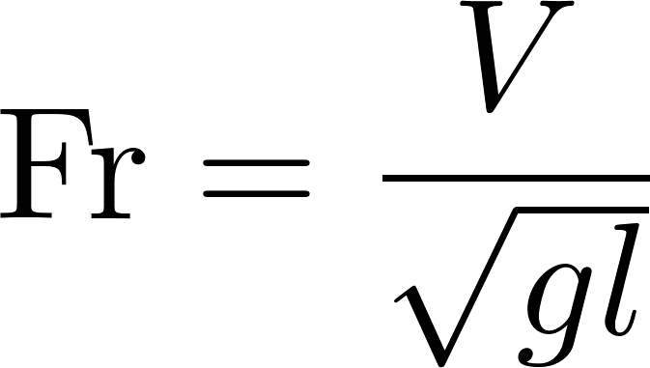
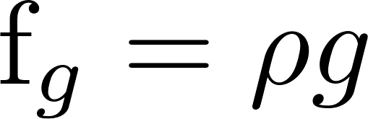
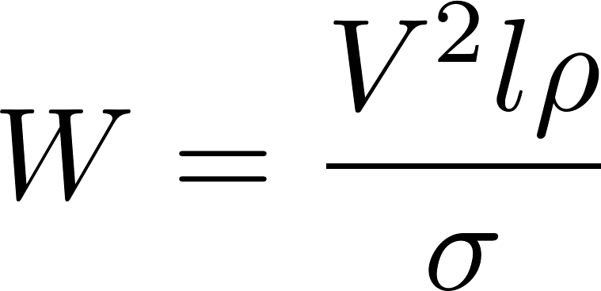
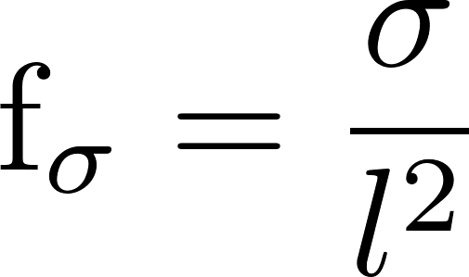
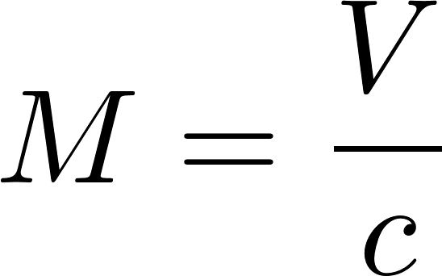
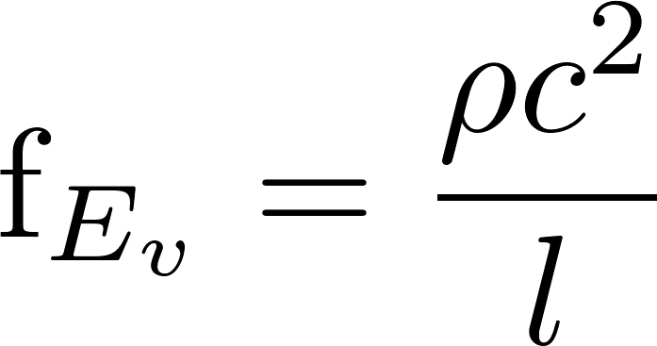
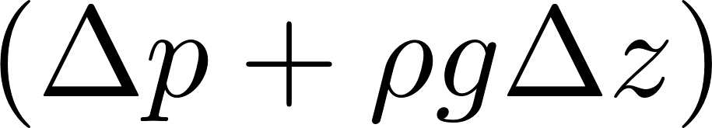
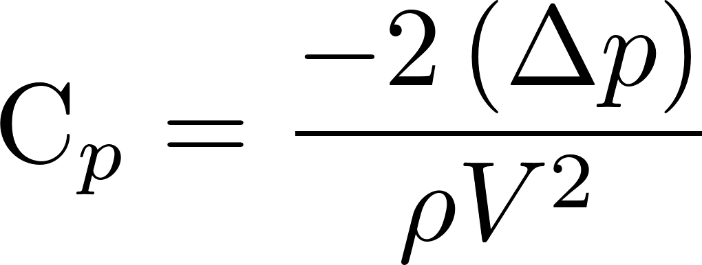
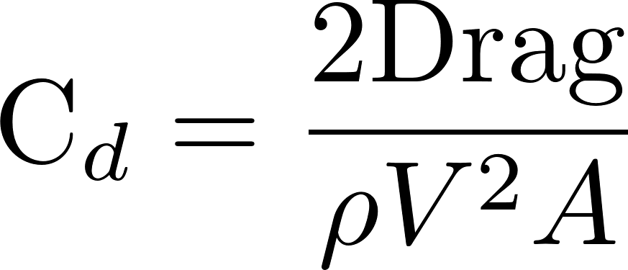
Dimensionless Force Ratios
Reynolds Number
Froude Number
Weber Number
Mach Number
Pressure/Drag Coefficients
(dependent parameters that we measure experimentally)

Slide 23
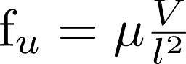
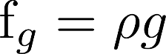
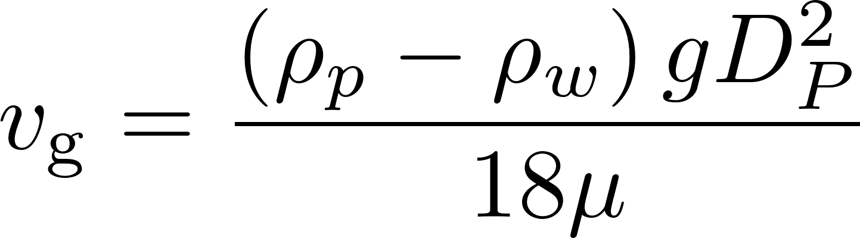
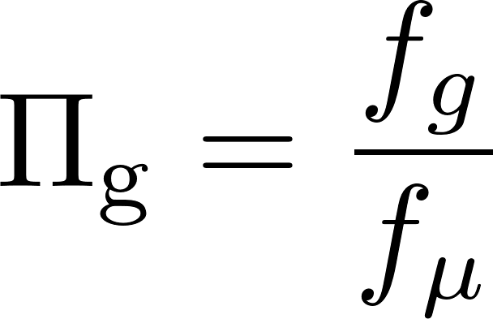
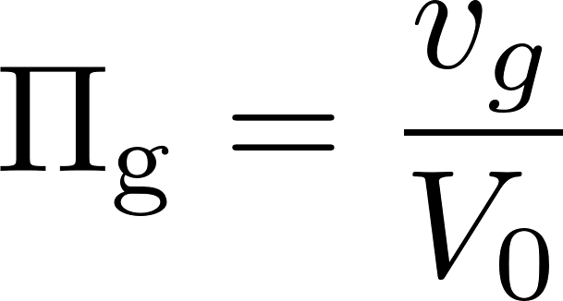
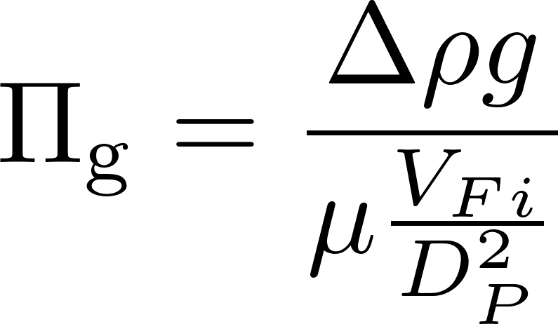
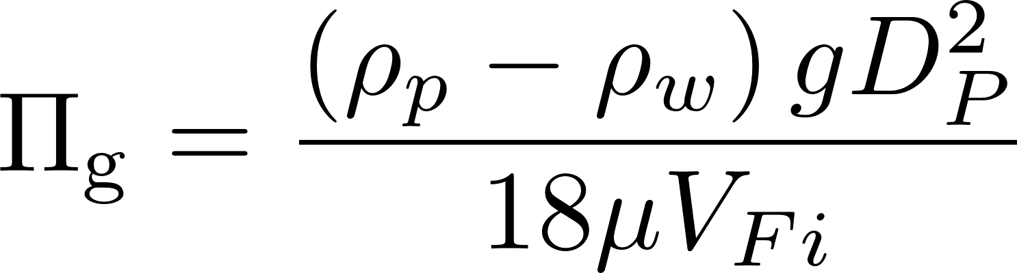
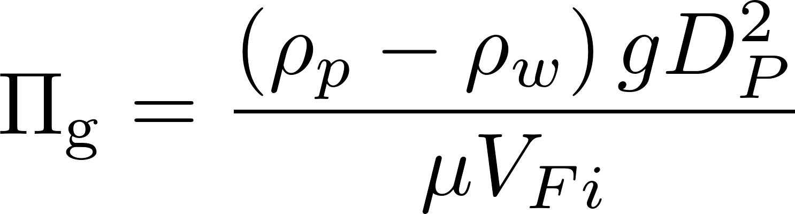
Gravity
velocities
forces
v
pore
Gravity only helps when the streamline has a _________ component.
horizontal
Use this definition

Slide 24
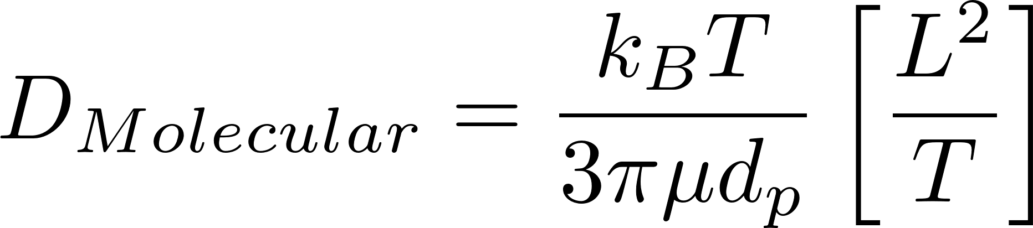
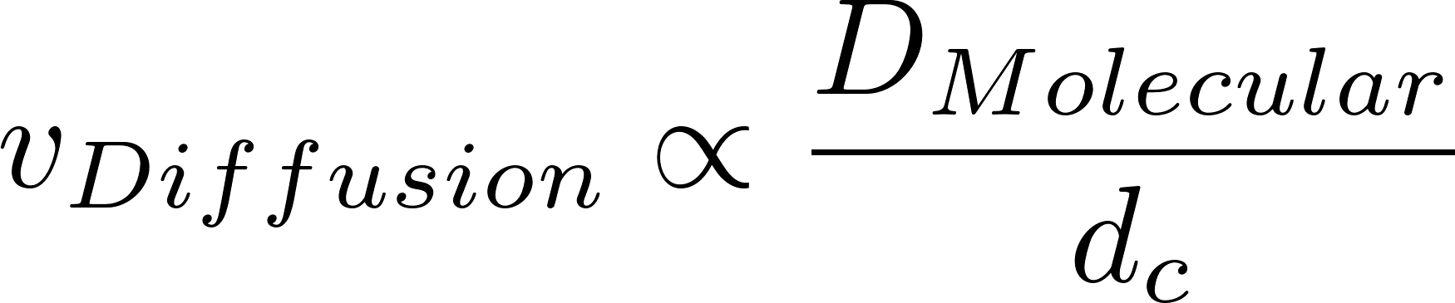
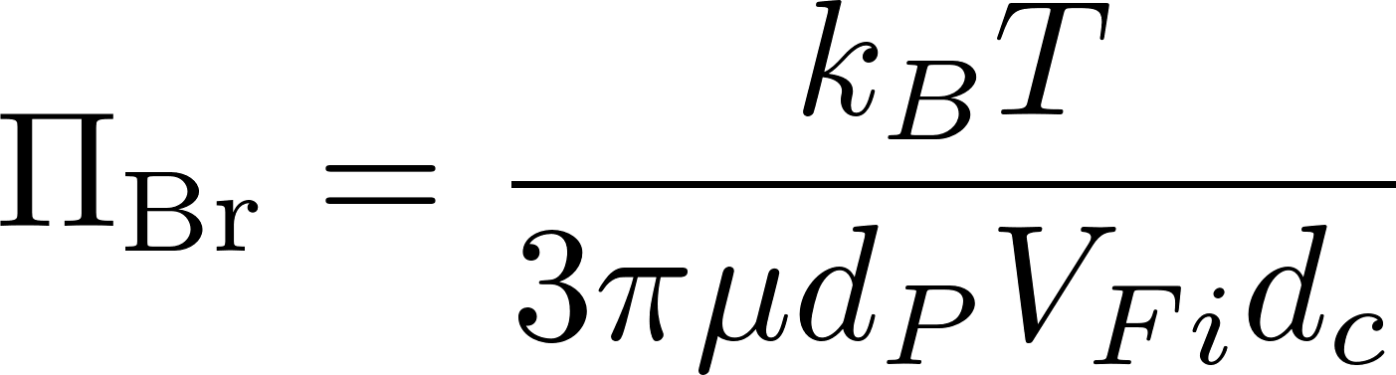
Diffusion (Brownian Motion)
v
pore
Diffusion velocity is high when the particle diameter is ________.
k_{B}=1.38 x 10⁻²³ J/°K
T = absolute temperature
small
d_{c} is diameter of the collector

Slide 25
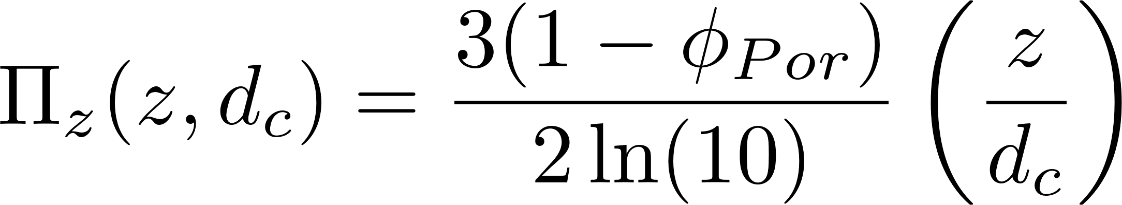
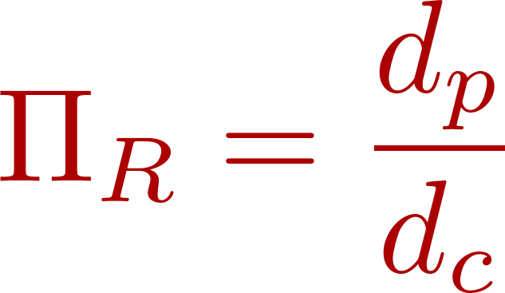
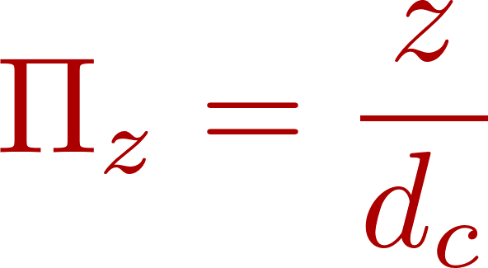
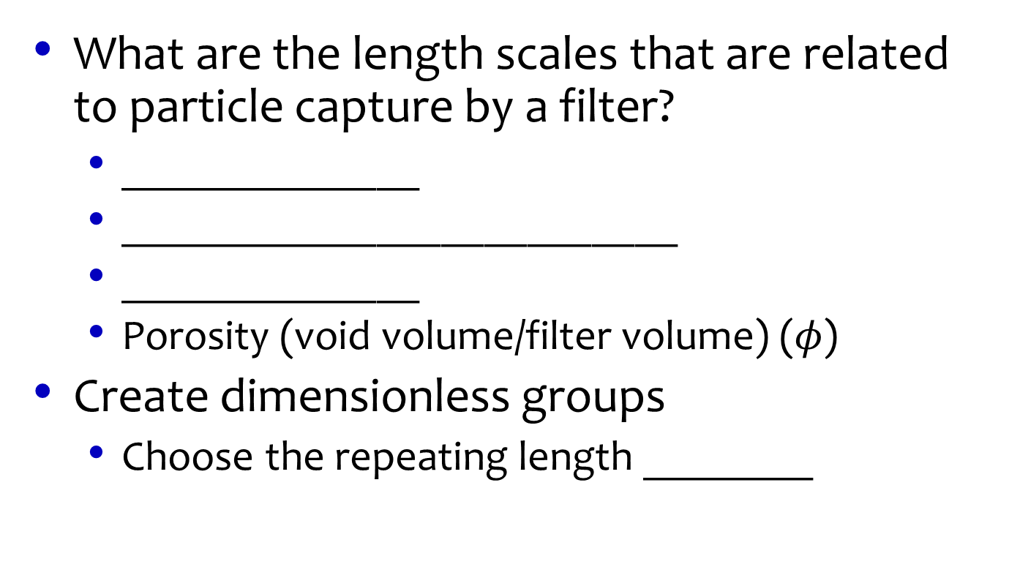
Geometric Parameters
What are the length scales that are related to particle capture by a filter?
______________
__________________________
______________
Porosity (void volume/filter volume) ($φ$)
Create dimensionless groups
Choose the repeating length ________
Filter depth (z)
Collector diameter (media size) (d_{c})
Particle diameter (d_{p})
(d_{c})
Number of collectors!
Definition used in model

Slide 26
Write the functional relationship
Length ratios
Force ratios
α=Attachment efficiency
doubles
If we double depth of filter what does pC* do? ___________
How do we get more detail on this functional relationship?
Empirical measurements
Numerical models

Slide 27
Filtration Model Limitations
Filtration model is really a “clean bed” model
Likely not able to explain performance during a filter run
Doesn’t account for pore filling
pC* is proportional to depth (not consistent with observations of operating filters)
pC* is independent of influent particle concentration (not consistent with observations of operating filters)
Influent particle size distribution is likely very important and may control pC* for real filters

Slide 28
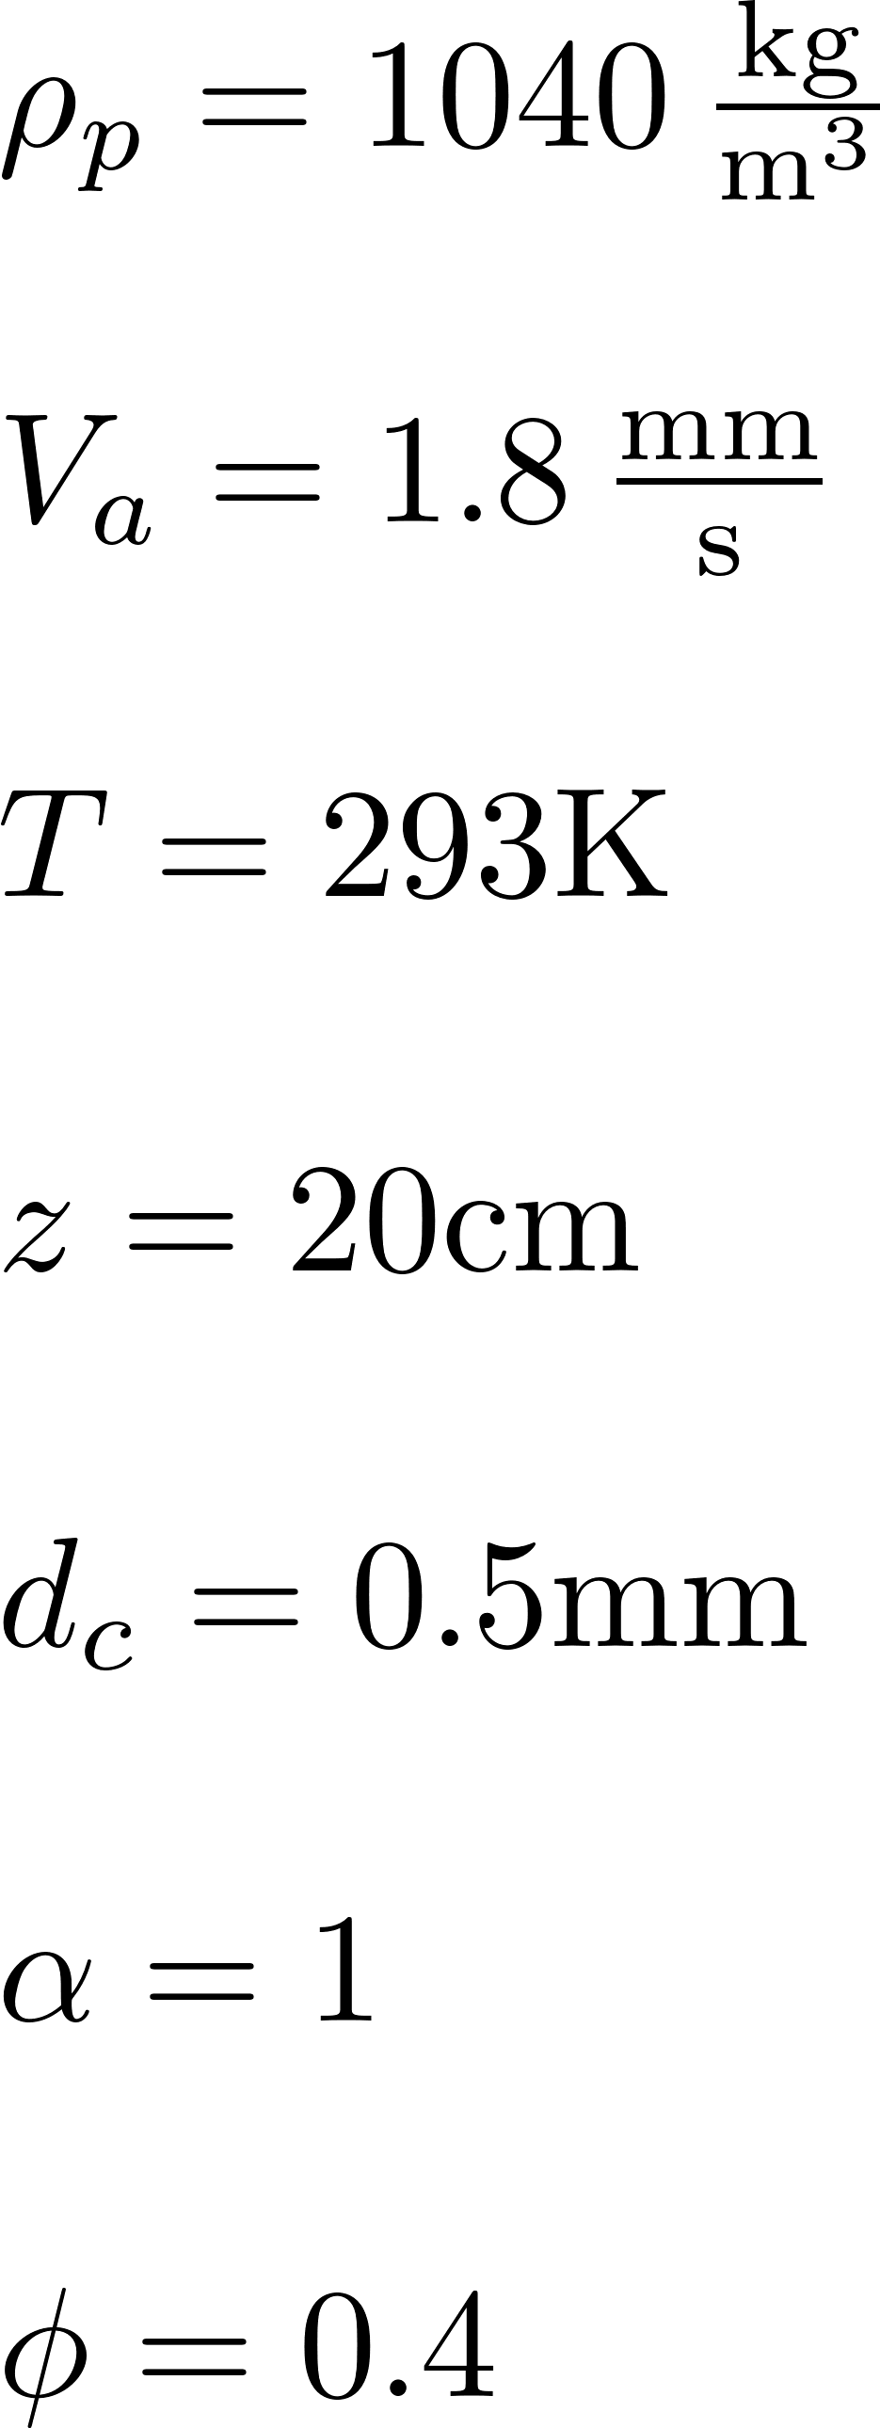
Stacked Rapid Sand Filter predicted performance for biological particle
Not very good at removing particles that haven’t been flocculated
Notes:
Interception is very important
Lousy at removing pathogens if they haven’t been flocculated
A 0.1mm particle has a pC* of 100!!!!!!!!!!
Either particles haven’t be
http://designserver.cee.cornell.edu/aguaclaracode/FiltrationModel.xmcden flocculated or attachment is poor

Slide 29

Stacked Rapid Sand Filter predicted performance for inorganic particle
What is the density of particles that are being removed in a StaRS Filter?
Notes:
Gravity is very important for these dense particles
http://designserver.cee.cornell.edu/aguaclaracode/FiltrationModel.xmcd

Slide 30
StaRS and Fractal Flocs predicted performance
The filtration model combined with the fractal flocculation model suggests that filtration is dominated by interception for all particles sizes for approach velocities above about 1 mm/s.
Notes:
http://designserver.cee.cornell.edu/aguaclaracode/FiltrationModel.xmcd
I see this as a big mystery. If a sticky clay particle can’t attach to a floc in a floc blanket, then is it possible for a clay particle to attach to a sand grain? It would seem that interception (the flocculation mechanism) might not be a viable mechanism for attaching little particles to big particles. So perhaps this is actually about sedimentation!

Slide 31
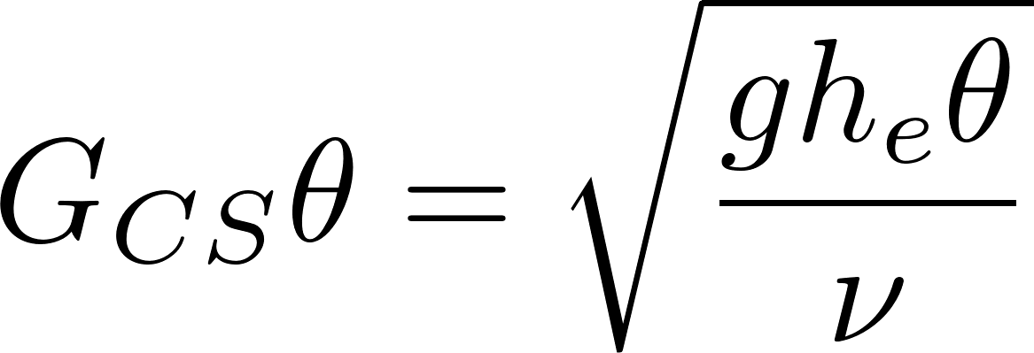
Filter as Flocculator?
Head loss of 40 cm
Residence time of 44 s
Gθ of 13,000!
Filter provides one last chance for flocculation especially after head loss increases

Slide 32
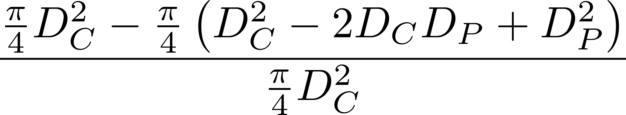
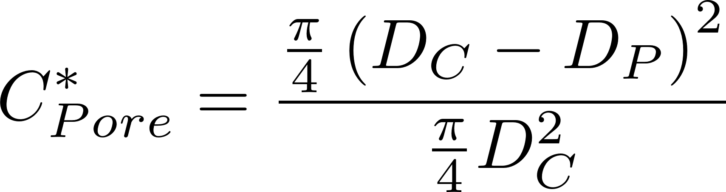
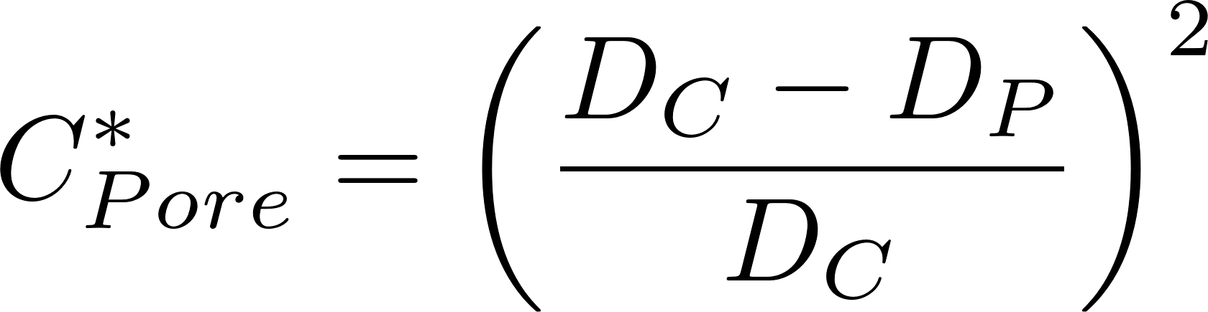
Interception
D_{E} Expanded diameter (big pore)
D_{C} Contracted diameter
D_{P} Particle diameter
What fraction of the particles slip through?
D_{E}
D_{C}
D_{P}

Slide 33
Small particles slip through a small restriction
Constriction diameter
The vast majority of small particles slide right through a constriction

Slide 34
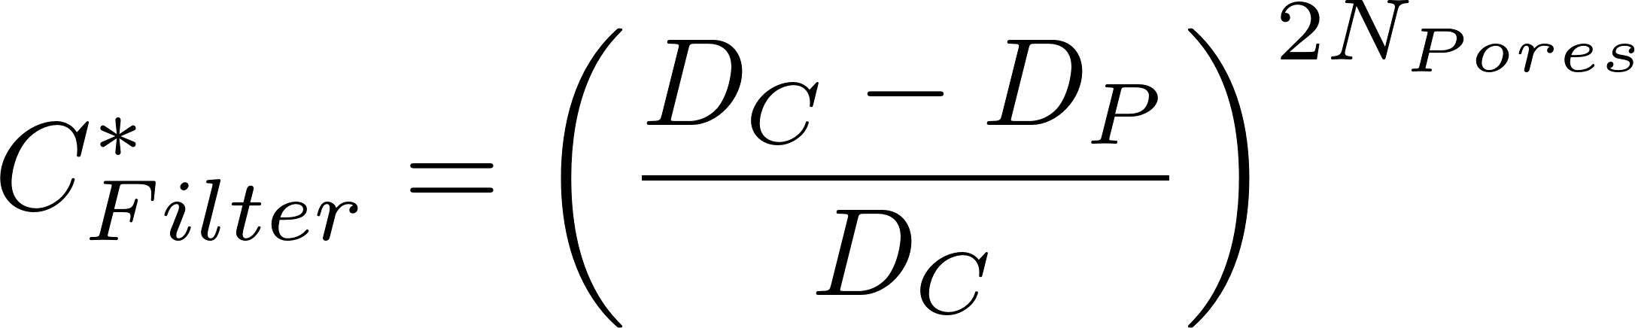
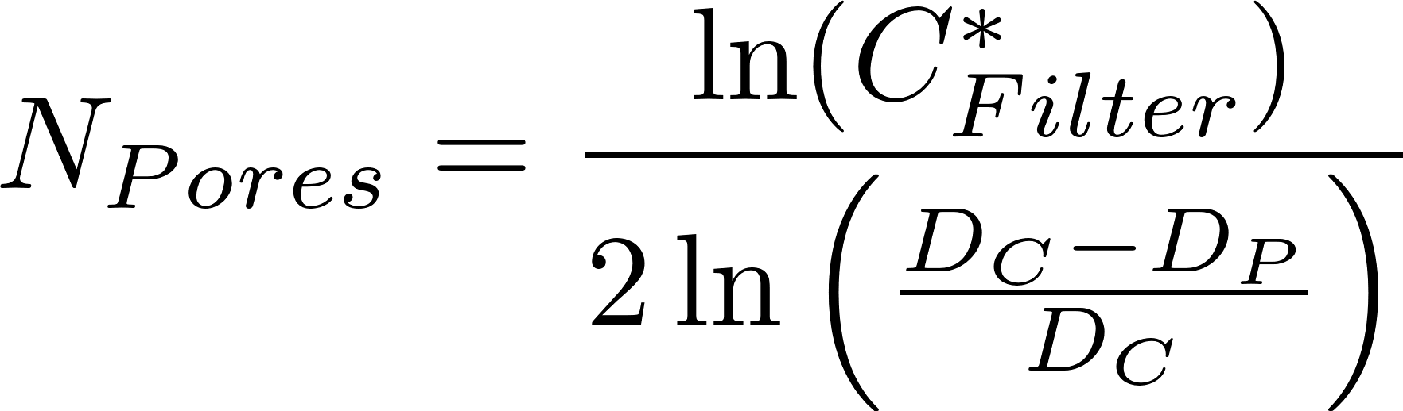
A series of restrictions takes a toll on even the small particles
If we assume complete mixing in each pore then the probability of slipping through N pores is
Number of pores to get 90% removal
Number of pores to get a target fraction remaining
How much mixing happens in each pore? Is the outer ring of fluid refreshed?

Slide 35
Tiny (or slippery) bad guys sneak through all the security
Some small particles escape flocculation, floc blanket, plate settlers, and filter
Because they are small (not likely because effluent turbidity stayed the same when flow rate was decreased in a filter)
Or because a few particles aren’t coated with nanoparticles (they are slippery)
Because they never got enough nanoparticles of coagulant
Or the nanoparticles were sheared off during
Failed attachments
Breakup
How could we determine if it is small size or lack of nanoparticles or something else?

Slide 36
What could cause slippery particles (with too few nanoparticles)?
Pulsing peristaltic pumps
Statistical variability given small number of nanoparticles per clay
Nanoparticles removed during unsuccessful collisions (this could occur during flocculation and/or during filtration

Slide 37
Flocs on their way to the filter
We use weirs and free fall to ensure that the flow is divided equally between filters and is not affected by the head loss of the filter
The elevation drop into the entrance box is approximately 0.4 m.
Velocity is 2.8 m/s
If we assume a 1 cm thick jet of water then the energy dissipation rate is 140 W/kg
The max diameter of a floc is thus 14 μm

Slide 38
Floc removal efficiency increases rapidly with floc size
Perhaps filter performance is largely controlled by the size distribution of influent flocs. We need particle size distribution entering and exiting the filter
Individual clay particles would be hard to capture
20 cm bed of 0.5 mm sand
Notes:
http://designserver.cee.cornell.edu/aguaclaracode/FiltrationModel.xmcd

Slide 39




Filtration of mixed particle sizes
Filtration model
Definition of pC* where i represents the bins containing different size fractions
Effluent concentration of each size class
Mixtures produce nonlinear relationship between pC* and filter bed depth

Slide 40
Methods to improve Rapid Sand Filter Performance
Increase attachment efficiency
Flocculate particles to make them larger
Add coagulant to the filter influent to make the filter media and previously captured particles stickier (50 μg/L of Al has been shown to be effective at Cornell Water Treatment Plant)
Po-Hsun Lin 2011
Notes:
Po-Hsun Lin

Slide 41


Flocculation may be a significant mechanism inside a filter
The equations are simplified major losses in a clean filter bed
Flocculation increases as head loss increases (another reason for this)
NTU
Time

Slide 42
StaRS Design Guidelines
Settled water is divided evenly between filters that are in filtration mode
Weir into entrance box
need to eliminate air entrainment problem
Backwash filter gets design flow
Each filter has an overflow box
Filtered water flows over a weir into a box taking water to the distribution tank

